Slide 1
Choosing a place to open a new mall in Cairo By Mostafa El Far October 2019

Slide 2
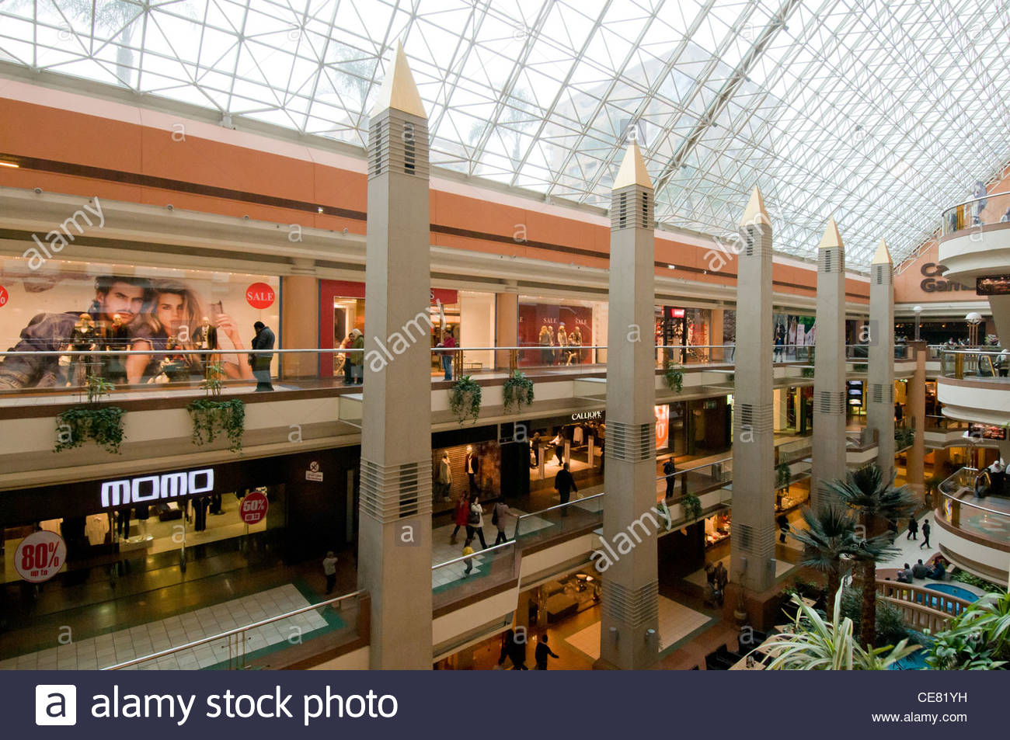
Content
Description and Problem Statement
Data Sources
Methodology
Discussion
Results
Conclusion

Slide 3
Project analysis slide 3
Introduction and
Research Question
MARKET ANALYSIS
TECHNICAL ANALYSIS
FINANCIAL ANALYSIS
ECOLOGICAL ANALYSIS
What is the best location among competitors?
What is the best location that is accessible and easy to reach?
What is the best location in a high-income neighborhood?
What is the best location overall to build up a new mall?

Slide 4
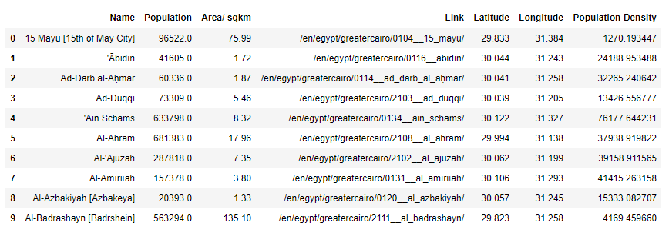
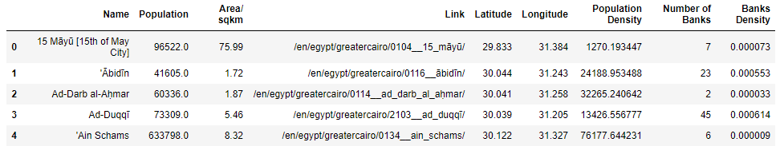
Project analysis slide 4
Data Sources
https://www.citypopulation.de/php/egypt-greatercairo.php
Through web scraping by BeautifulSoup
Demographics of each neighborhood is obtained
Foursquare API
Using search queries
Information about banks and malls in each neighborhood is obtained

Slide 5
Project analysis slide 4
Methodology
Content
Data Visualization
Maps
Histograms
Data Analysis
Correlation
Heat Maps
K-means Clustering

Slide 6
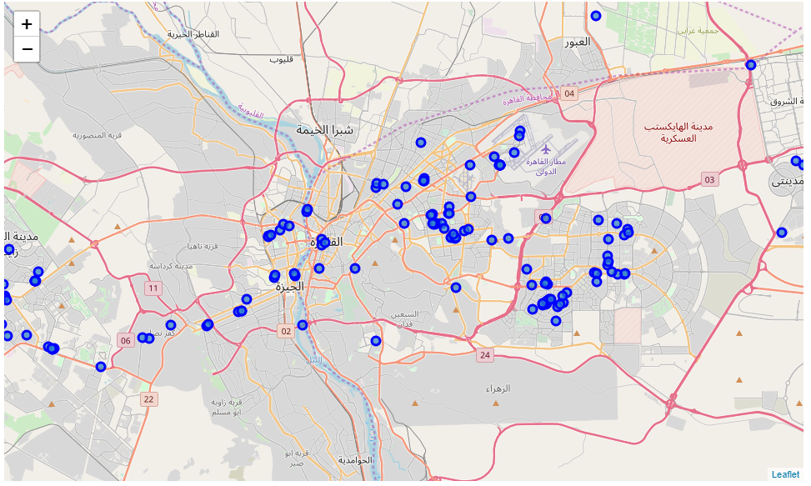
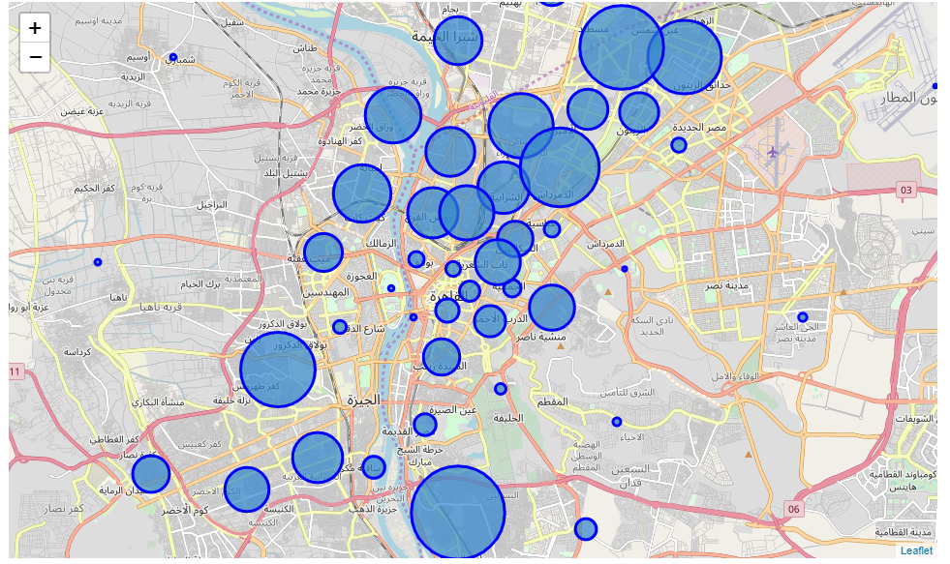
Project analysis slide 8
Data Visualization
Maps
Map of all malls in Cairo
Map of all neighborhoods in Cairo. Radius of circle show population density
It is clear that the distribution of Cairo population is high in the center of Cairo, while in the suburb density is low. Also in the island in the middle of Cairo and around it, population density is low. Malls are well distributed around Cairo.

Slide 7
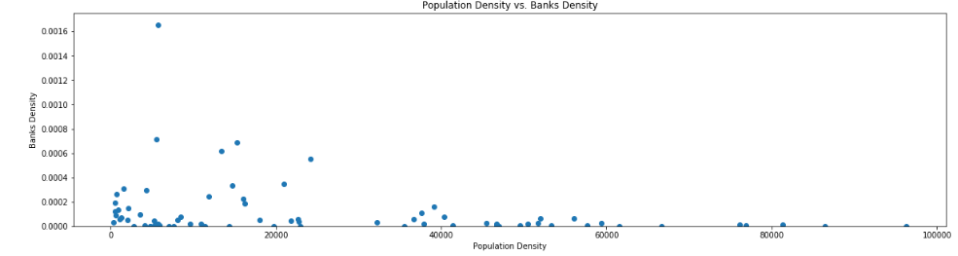
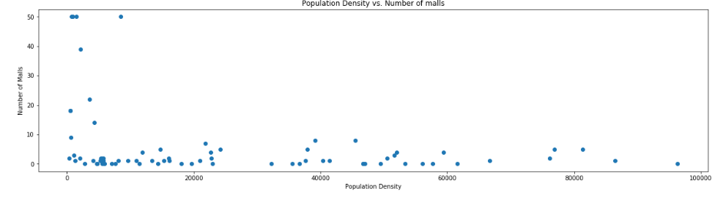
Project analysis slide 10
Exploratory Data
Analysis
Scatter plots are used to get an initial view of the trends of the variables. When the population density is low, banks density and number of malls increase. This is due to several factors. When population density decreases, places are easier to be accessible and people can reach malls faster. Also, richer people tend to live in bigger places, i.e. big houses, that is why there are many banks where the population density is low. Also, malls tend to open closer to richer people.
Thus, the Pearson correlation was calculated. Correlation between population density and number of malls is -0.2911016155620632 while correlation between population density and banks density is -0.24923281466862976.

Slide 8
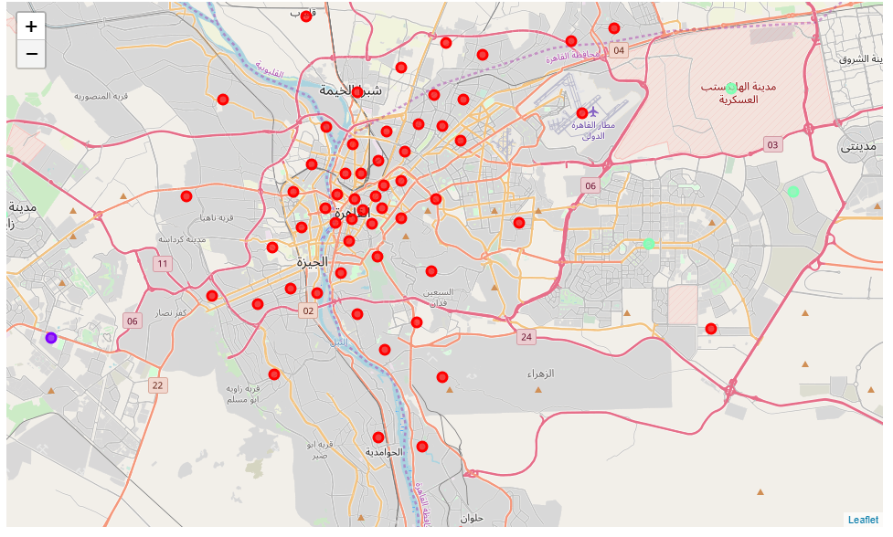
Project analysis slide 10
K-means Clustering
Then, to distribute the data, k-means clustering algorithm was used. It produced three clusters. Clusters 1 and 2 where the newer parts of Cairo while cluster 0 are the older parts. This was visualized using a map where the red circles are cluster 0 while the other circles were clusters 1 and 2.
To understand how the clustering algorithm worked the means of the data was calculated. The mean population density of cluster 2 and 3 is 1061.216 while the mean population density of cluster 0 is 27582.167. The mean banks density of cluster 2 and 3 is 0.000194 while the mean banks density of cluster 0 is 0.000108. Outskirts have a much less population density, of just 1061 /sq. km compared to a whopping 27,580 in places inside the city. Also, the bank density is double than that of the places inside the city. Outskirts are generally less crowded and more expensive with higher income.
Cluster 0
Cluster 1
Cluster 2

Slide 9
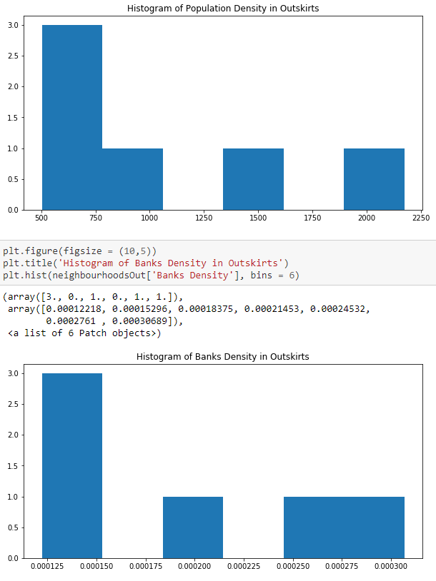
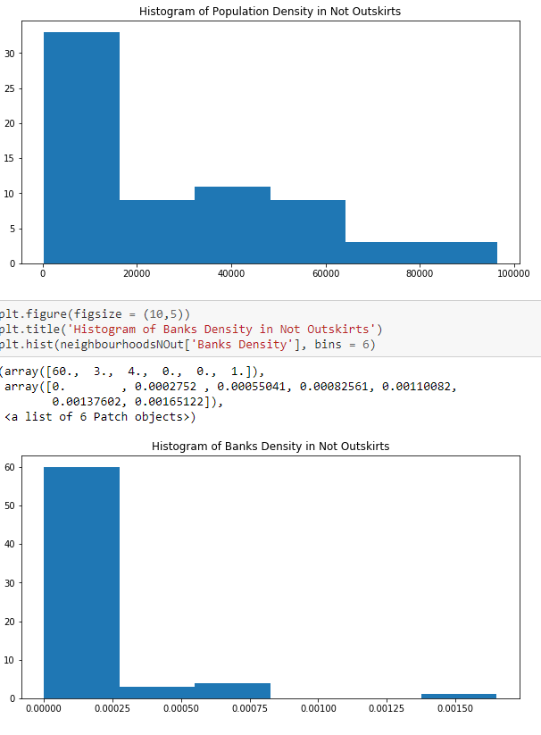
Project analysis slide 10
Histogram of
densities
The data was divided into 2 groups, outskirts and not outskirts, where not outskirts are cluster 0 while outskirts are clusters 1 and 2. The distribution of the data in the 2 groups was analyzed by analyzing the histogram of them. These histograms showed the same results as the means that were previously examined.

Slide 10
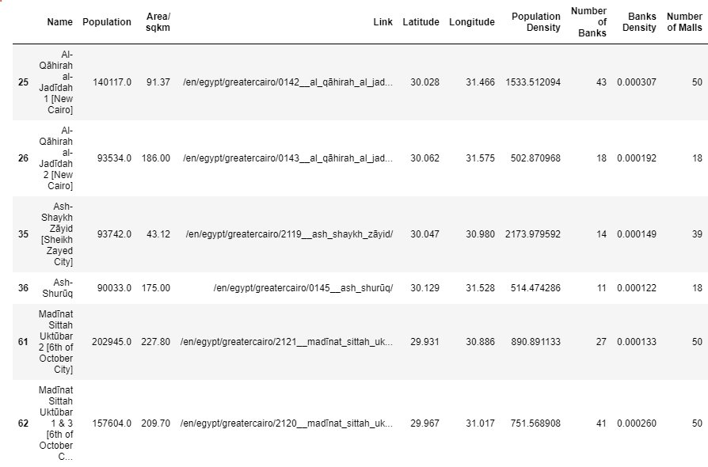
Project analysis slide 10
Results
All this analysis show that the only possible places to open mall are the outskirts that were collected in the first cluster. They have relatively low or moderate population density that will allow the newly built mall to be easily accessible in the crowds of Cairo. Also, these places are richer than other places that are not crowded. They also tend to have a higher number of malls which indicates that the shopping in these areas is actively growing.

Slide 11
Project analysis slide 10
Conclusion
To conclude this report. Data science was used to explore the possible neighborhoods that would be suitable to open a new mall. Data was collected from web scraping citypopulation.de and from the Foursquare API. The data collected included information like neighborhood names, population, population density, banks and malls. Several data analysis techniques were used like clustering. Data visualization tools was also used to completely understand the data, such as heat maps, maps and histograms. In the end, a few neighborhoods were selected to be the most suitable for opening a mall.

Slide 12
Thank You

